Slide 1
Midterm Review
Rao Vemuri
16 Oct 2013

Slide 2
Posing a Machine Learning Problem
Experience Table
Each row is an instance
Each column is an attribute/feature
The last column is a class label/output
Mathematically, you are given a set of ordered pairs {(x,y)} where x is a vector. The elements of this vector are attributes or features
The table is referred to as D, the data set
Our goal is to build a model M (or hypothesis h)

Slide 3
Types of Problems
Classification: Given a data set D, develop a model (hypothesis) such that the model can predict the class label (last column) of a new instance not seen before
Regression: Given a data set D, develop a model (hypothesis) such that the model can predict the (real-valued) output (last column) of a new input not seen before

Slide 4
Types of Problems
Density Distribution: Given a data set D, develop a model (hypothesis) such that the model can predict the probability distribution from which the data set is drawn.

Slide 5
Decision Trees
We talked mostly about ID3
Entropy
Gain in Entropy
Given an Experience Table, you must be able to decide on what attribute to split using entropy method and build a DT
There are other methods like Gini, but you are not responsible for those

Slide 6
Advantages of DT
Simple to understand and easy to interpret.
When we fit a decision tree to a training dataset, the top few nodes on which the tree is split are essentially the most important variables within the dataset and feature selection is completed automatically!
If we have a dataset which measures revenue in millions and loan age in years, say; this will require some form of normalization or scaling before we can fit a regression model and interpret the coefficients. Such variable transformations are not required with decision trees because the tree structure will remain the same with or without the transformation.

Slide 7
Disadvantages of DT
For data including categorical variables with different number of levels, information gain in decision trees are biased in favor of those attributes with more levels.
Calculations can get very complex particularly if many values are uncertain and/or if many outcomes are linked.

Slide 8
Mathematical Model of a Neuron
A neuron produces an output if the weighted sum of the inputs exceeds a threshold, theta.
For convenience, we represent the threshold as w_0 connected to an input +1
Now the net input to a neuron can be written as the dot (inner) product of the weight vector w and input vector x.
The output is f(net input)

Slide 9
Perceptron
In a Perceptron, the function f is the signum (sign) function. That is, the output is +1 if the net input is > 0 and -1 if <= 0
Training rule:
New wt = old wt + eta (error) input
Error = target output – actual output = (t – y)
NOTE: The error is always +/- 2 or 0
Weight updates occur only when error =/ 0

Slide 10
Adaline
In an Adaline, the function f(x) = x. That is, the output is the same as net input
Training rule:
New wt = old wt + eta (error) input
Error = target output – actual output = (t – y)

Slide 11
Delta Rule
In Delta Rule, the function f is the sigmoid function. Now, the output is in [0,1]
Training rule:
New wt = old wt + eta (error) input
Error = target output – actual output = (t – y)
NOTE: The error is a real number

Slide 12
Generalized Delta Rule
This is Delta Rule applied to multi-layered networks
In multi-layered, feed-forward networks we only know the error (t-y) at the output stage, because t is only given at the output.
So we can calculate weight updates at the output layer using the Delta Rule

Slide 13
Weight Updates at Hidden Level
To calculate the weight updates at the hidden layer, we need “what the error should be” at the hidden unit(s).
This is done by taking the output error and multiplying it by the weight between the said units, and adding the propagated values.
Then the Delta Rule is applied again.

Slide 14
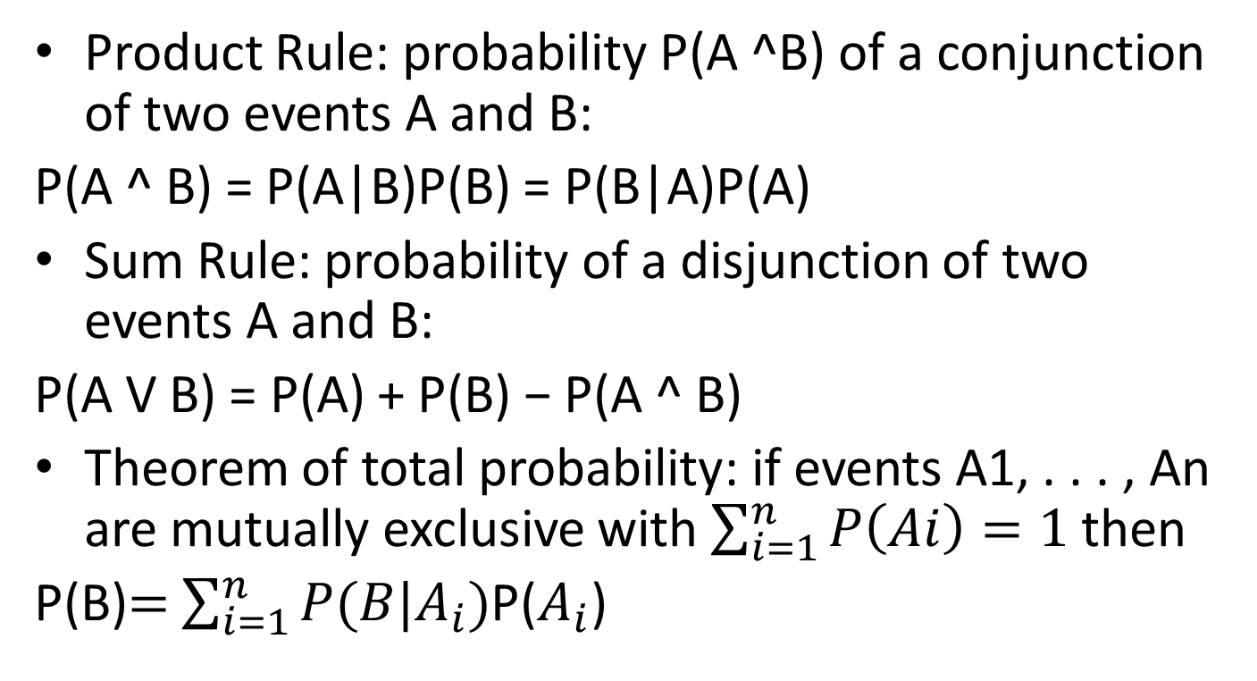
Basic Probability Formulas
Product Rule: probability P(A ^B) of a conjunction of two events A and B:
P(A ^ B) = P(A|B)P(B) = P(B|A)P(A)
Sum Rule: probability of a disjunction of two events A and B:
P(A V B) = P(A) + P(B) − P(A ^ B)
Theorem of total probability: if events A1, . . . , An are mutually exclusive with $\sum_{i=1}^{n}{P\left(Ai\right)=1}$ then
P(B)$=$ $\sum_{i=1}^{n}{P(B|A_{i})}$P($A_{i}$)

Slide 15
Probability for Bayes Method
Concept of independence is central
In Machine Learning we are interested in determining the best hypothesis h from a set of hypotheses H, given training data set D
In probability language, we want the most probable hypothesis,
given the training data set D
Any other information about the probabilities of various hypotheses in H (prior probabilities)

Slide 16
Two Roles for Bayesian Methods
Provides practical learning algorithms:
Naive Bayes learning
Bayesian belief network learning
Combine prior knowledge (prior probabilities) with observed data
Requires prior probabilities
Provides useful conceptual framework
Provides “gold standard” for evaluating other learning algorithms
Additional insight into Occam’s razor

Slide 17
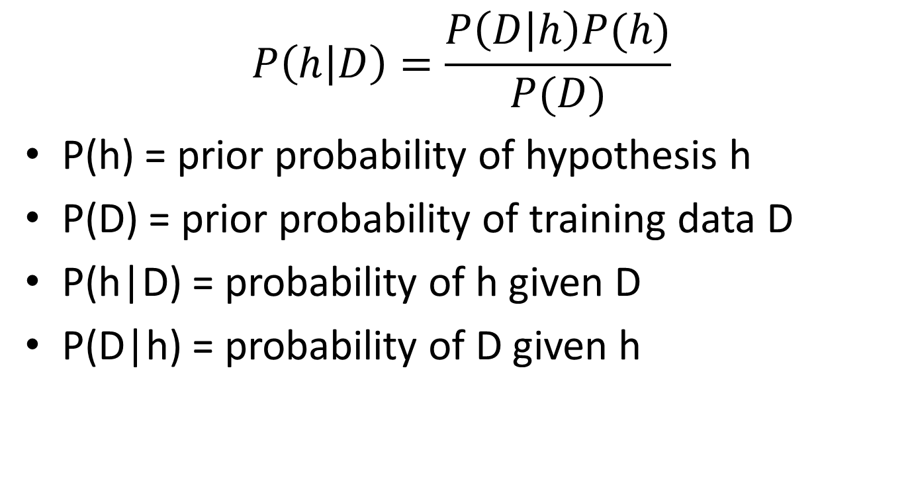
Bayes Theorem
$$P\left(h | D\right)=\frac{P\left(D | h\right)P(h)}{P(D)}$$
P(h) = prior probability of hypothesis h
P(D) = prior probability of training data D
P(h|D) = probability of h given D
P(D|h) = probability of D given h

Slide 18
Notation
P(h) = Initial probability (or prior probability) that hypothesis h holds
P(D) = prior probability that data D will be observed (independent of any hypothesis)
P(D|h) = probability that data D will be observed, given hypothesis h holds.
P(h|D) = probability that h holds, given training data D. This is called posterior probability

Slide 19
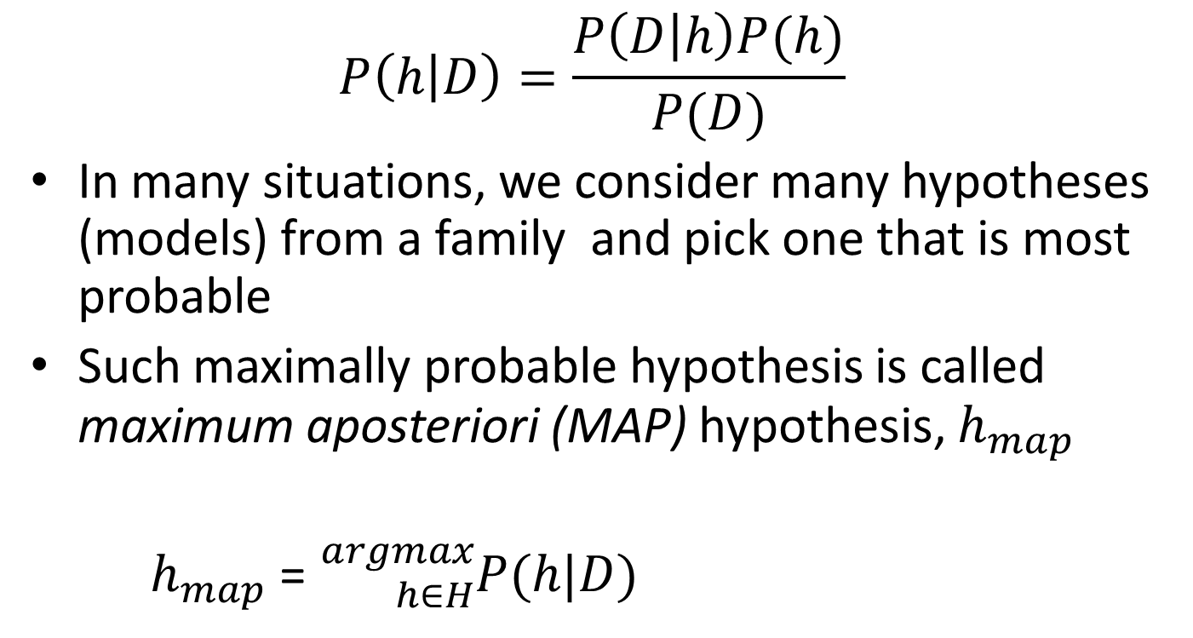
Bayes Theorem for ML
$$P\left(h | D\right)=\frac{P\left(D | h\right)P(h)}{P(D)}$$
In many situations, we consider many hypotheses (models) from a family and pick one that is most probable
Such maximally probable hypothesis is called maximum aposteriori (MAP) hypothesis, $h_{map}$
$h_{map}$ = ${}_{h∈H}^{argmax}{P(h|D)}$

Slide 20
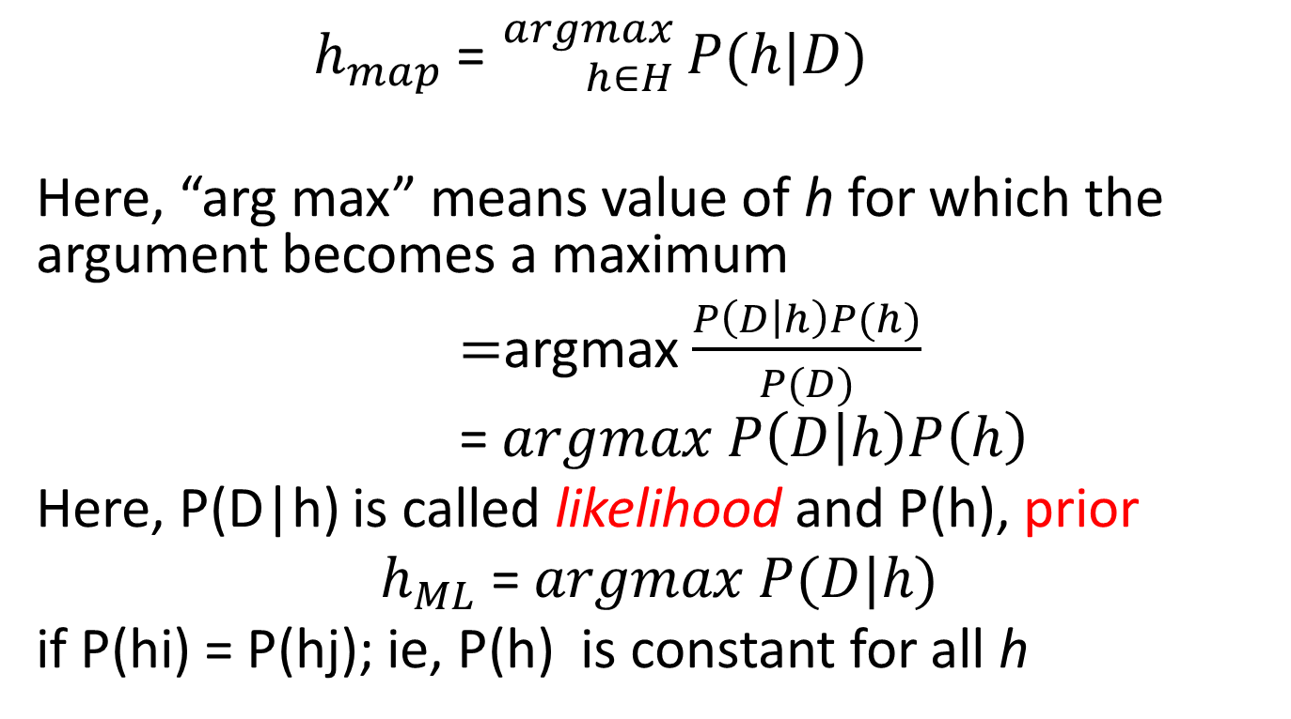
Maximum Likelihood Hypothesis
$h_{map}$ = ${}_{h∈H}^{argmax}{ P(h|D)}$
Here, “arg max” means value of h for which the argument becomes a maximum
$=$argmax $\frac{P\left(D | h\right)P(h)}{P(D)}$
= $argmax P\left(D | h\right)P\left(h\right)$
Here, P(D|h) is called likelihood and P(h), prior
$h_{ML}$ =$argmax P(D|h)$
if P(hi) = P(hj); ie, P(h) is constant for all h

Slide 21
Patient has Cancer or Not?
A patient takes a lab test and the result comes back
positive. The test returns a correct positive result in only
98% of the cases in which the disease is actually present,
and a correct negative result in only 97% of the cases in
which the disease is not present. Furthermore, .008 of
the entire population have this cancer.
P(cancer ) = P(¬cancer ) =
P(+|cancer ) = P(−|cancer ) =
P(+|¬cancer ) = P(−|¬cancer ) =

Slide 22
Medical Diagnosis
Two alternatives
Patient has cancer
Patient has no cancer
Data: Laboratory test with two outcomes
+ Positive, Patient has cancer
- Negative, Patient has no cancer
Prior Knowledge:
In the population only 0.008 have cancer
Lab test is correct in 98% of positive cases
Lab test is correct in 97% of negative cases

Slide 23
Probability Notation
P(cancer) = 0.008; P(~cancer) = 0.992
P(+Lab|cancer) = 0.98; P(-Lab|cancer) =0.02
P(+Lab|~cancer)=0.03; P(-lab|~cancer)=0.97
This is the given data in probability notation.
Notice the blue items are actually given and the red are inferred

Slide 24
Brute Force MAP Hypothesis Learner
A new patient gets examined and the test says he has cancer. Does he? Doesn’t he?
To find the MAP hypothesis, for each hypothesis h in H, calculate the posterior probabilities, P(h|D):
P(+lab|cancer)P(can) = (0.98)(.008)=0.0078
P(+lab|~cancer)P(~can) = (0.03)(.992)=0.0298

Slide 25
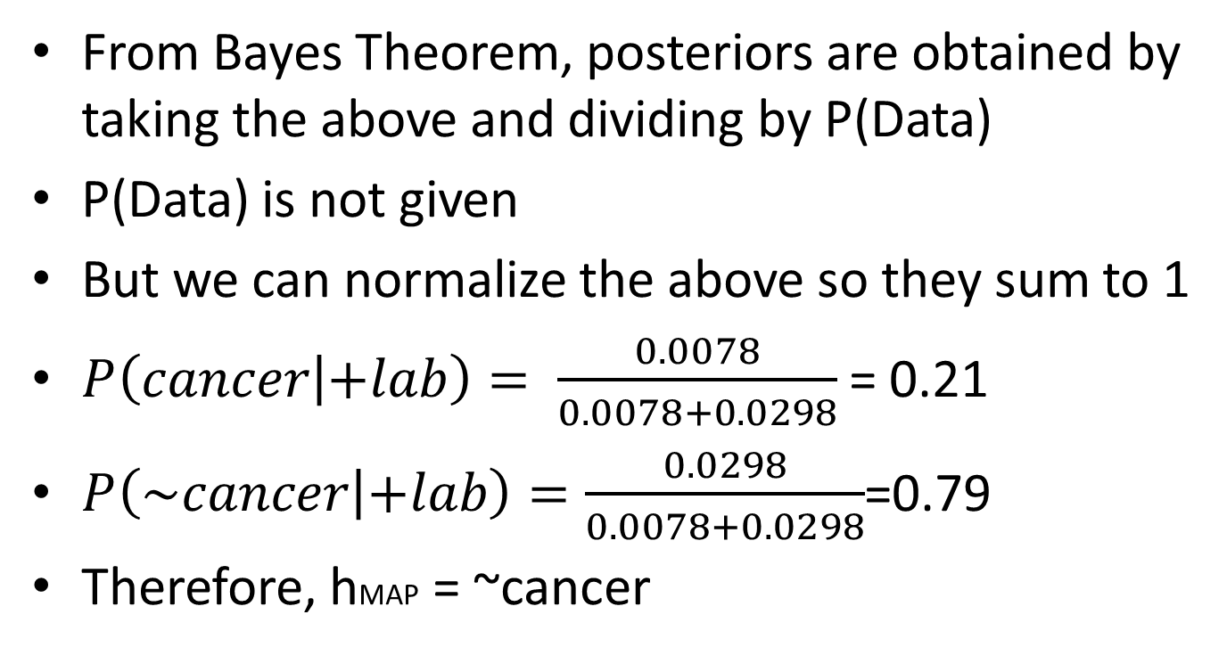
Posterior Probabilities
From Bayes Theorem, posteriors are obtained by taking the above and dividing by P(Data)
P(Data) is not given
But we can normalize the above so they sum to 1
$P\left(cancer | +lab\right)= \frac{0.0078}{0.0078+0.0298}$= 0.21
$P\left(\sim cancer | +lab\right)=\frac{0.0298}{0.0078+0.0298}$=0.79
Therefore, hMAP = ~cancer

Slide 26
Genetic Algorithms
I will NOT ask questions on Genetic Algorithms in the midterm examination
I will not ask questions on MATLAB in the examination

